Slide 1
Share your thoughts
Who is the Holy Spirit?

Slide 2
Genesis 1:1-2 | In the beginning God created the heavens and the earth. The earth was formless and empty, and darkness covered the deep waters. And the Spirit of God was hovering over the surface of the waters.
Psalm 143:10 | Teach me to do your will, for you are my God. May your gracious Spirit lead me forward on a firm footing.
Ezekiel 36:25-27 | Then I will sprinkle clean water on you, and you will be clean. Your filth will be washed away, and you will no longer worship idols. And I will give you a new heart, and I will put a new spirit in you. I will take out your stony, stubborn heart and give you a tender, responsive heart. And I will put my Spirit in you so that you will follow my decrees and be careful to obey my regulations.
John 14:26 | But when the Father sends the Advocate as my representative—that is, the Holy Spirit—he will teach you everything and will remind you of everything I have told you.
Matthew 28:19 | Therefore, go and make disciples of all the nations, baptizing them in the name of the Father and the Son and the Holy Spirit.
Ephesians 4:30 | And do not bring sorrow to God’s Holy Spirit by the way you live. Remember, he has identified you as his own, guaranteeing that you will be saved on the day of redemption.
1 Corinthians 6:19-20 | Don’t you realize that your body is the temple of the Holy Spirit, who lives in you and was given to you by God? You do not belong to yourself, for God bought you with a high price. So you must honor God with your body.

Slide 3
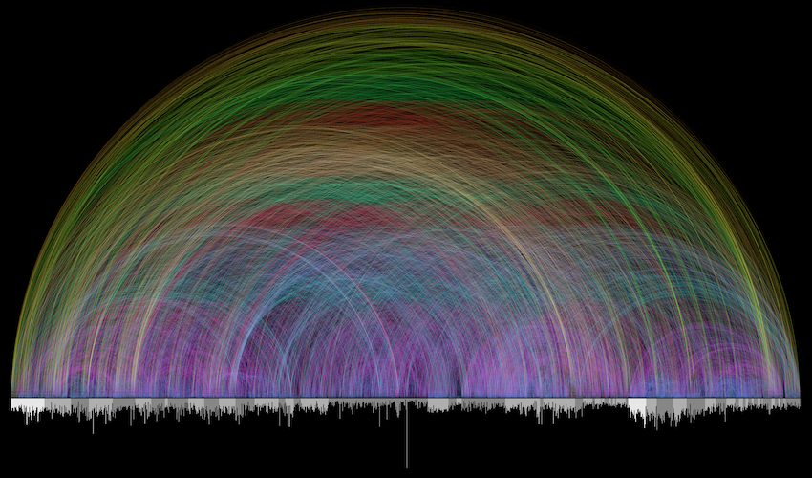
The Day of Pentecost – Acts 2

Slide 4
Acts 1:3, 6-9
During the forty days after Jesus suffered and died, he appeared to the apostles from time to time, and he proved to them in many ways that he was actually alive. And he talked to them about the Kingdom of God…
So when the apostles were with Jesus, they kept asking him, “Lord, has the time come for you to free Israel and restore our kingdom?”
He replied, “The Father alone has the authority to set those dates and times, and they are not for you to know. But you will receive power when the Holy Spirit comes upon you. And you will be my witnesses, telling people about me everywhere—in Jerusalem, throughout Judea, in Samaria, and to the ends of the earth.”
After saying this, he was taken up into a cloud while they were watching, and they could no longer see him.

Slide 5
Acts 2:1-42
On the day of Pentecost[f] all the believers were meeting together in one place. Suddenly, there was a sound from heaven like the roaring of a mighty windstorm, and it filled the house where they were sitting. Then, what looked like flames or tongues of fire appeared and settled on each of them. And everyone present was filled with the Holy Spirit and began speaking in other languages, as the Holy Spirit gave them this ability.
At that time there were devout Jews from every nation living in Jerusalem. When they heard the loud noise, everyone came running, and they were bewildered to hear their own languages being spoken by the believers.

Slide 6
Acts 2:1-42
They were completely amazed. “How can this be?” they exclaimed. “These people are all from Galilee, and yet we hear them speaking in our own native languages! Here we are—Parthians, Medes, Elamites, people from Mesopotamia, Judea, Cappadocia, Pontus, the province of Asia, Phrygia, Pamphylia, Egypt, and the areas of Libya around Cyrene, visitors from Rome (both Jews and converts to Judaism), Cretans, and Arabs. And we all hear these people speaking in our own languages about the wonderful things God has done!” They stood there amazed and perplexed. “What can this mean?” they asked each other.
But others in the crowd ridiculed them, saying, “They’re just drunk, that’s all!”.

Slide 7
Acts 2:1-42
Then Peter stepped forward with the eleven other apostles and shouted to the crowd, “Listen carefully, all of you, fellow Jews and residents of Jerusalem! Make no mistake about this. These people are not drunk, as some of you are assuming. Nine o’clock in the morning is much too early for that. No, what you see was predicted long ago by the prophet Joel:
‘In the last days,’ God says,
‘I will pour out my Spirit upon all people.
Your sons and daughters will prophesy.
Your young men will see visions,
and your old men will dream dreams.

Slide 8
Acts 2:1-42
In those days I will pour out my Spirit
even on my servants—men and women alike—
and they will prophesy.
And I will cause wonders in the heavens above
and signs on the earth below—
blood and fire and clouds of smoke.
The sun will become dark,
and the moon will turn blood red
before that great and glorious day of the Lord arrives.
But everyone who calls on the name of the Lord
will be saved.’
“People of Israel, listen! God publicly endorsed Jesus the Nazarene[i] by doing powerful miracles, wonders, and signs through him, as you well know. But God knew what would happen, and his prearranged plan was carried out when Jesus was betrayed. With the help of lawless Gentiles, you nailed him to a cross and killed him. But God released him from the horrors of death and raised him back to life, for death could not keep him in its grip.

Slide 9
Acts 2:1-42
King David said this about him:
‘I see that the Lord is always with me.
I will not be shaken, for he is right beside me.
No wonder my heart is glad,
and my tongue shouts his praises!
My body rests in hope.
For you will not leave my soul among the dead[j]
or allow your Holy One to rot in the grave.
You have shown me the way of life,
and you will fill me with the joy of your presence.’

Slide 10
Acts 2:1-42
Dear brothers, think about this! You can be sure that the patriarch David wasn’t referring to himself, for he died and was buried, and his tomb is still here among us. But he was a prophet, and he knew God had promised with an oath that one of David’s own descendants would sit on his throne. David was looking into the future and speaking of the Messiah’s resurrection. He was saying that God would not leave him among the dead or allow his body to rot in the grave.

Slide 11
Acts 2:1-42
“God raised Jesus from the dead, and we are all witnesses of this. 33 Now he is exalted to the place of highest honor in heaven, at God’s right hand. And the Father, as he had promised, gave him the Holy Spirit to pour out upon us, just as you see and hear today. For David himself never ascended into heaven, yet he said,
‘The Lord said to my Lord,
“Sit in the place of honor at my right hand
until I humble your enemies,
making them a footstool under your feet.”’

Slide 12
Acts 2:1-42
“So let everyone in Israel know for certain that God has made this Jesus, whom you crucified, to be both Lord and Messiah!”
Peter’s words pierced their hearts, and they said to him and to the other apostles, “Brothers, what should we do?”
Peter replied, “Each of you must repent of your sins and turn to God, and be baptized in the name of Jesus Christ for the forgiveness of your sins. Then you will receive the gift of the Holy Spirit. This promise is to you, to your children, and to those far away—all who have been called by the Lord our God.”

Slide 13
Acts 2:1-42
Then Peter continued preaching for a long time, strongly urging all his listeners, “Save yourselves from this crooked generation!”
Those who believed what Peter said were baptized and added to the church that day—about 3,000 in all.
All the believers devoted themselves to the apostles’ teaching, and to fellowship, and to sharing in meals (including the Lord’s Supper), and to prayer.

Slide 14
The Day of Pentecost – Acts 2
Connecting the Old and the New
Understanding the Present
Graham Grove, June, 2022

Slide 15
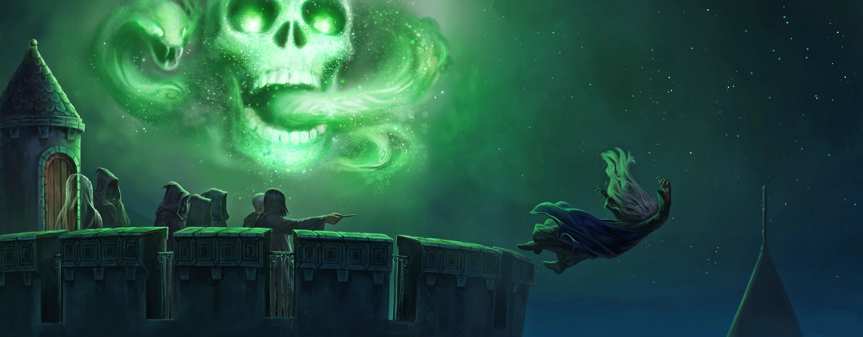

Slide 16
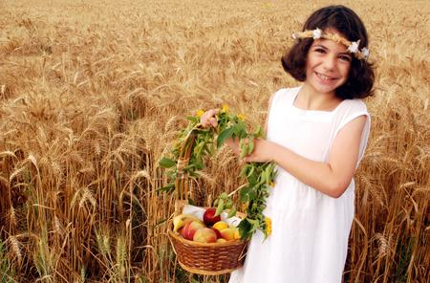
The History of Pentecost
Pentecost – it was…
Part of the Old Testament or Covenant
Pentecost – it shows that…
God gives what is needed to sustain life
You must celebrate the Festival of Harvest (Pentecost) with the first crop of the wheat harvest…
Exodus 34:22
When you harvest the crops of your land (at Pentecost), do not harvest the grain along the edges of your field, and do not pick up what the harvesters drop. Leave it for the poor and the foreigners living among you. I am the Lord
Leviticus 23:22

Slide 17
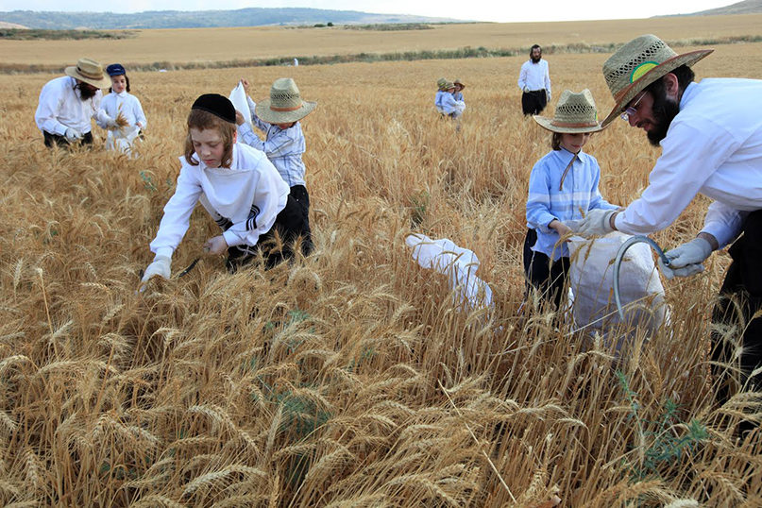
The History of Pentecost
Pentecost – it shows that…
God wishes to sustain the foreigner too
You must celebrate the Festival of Harvest (Pentecost) with the first crop of the wheat harvest…
Exodus 34:22
When you harvest the crops of your land (at Pentecost), do not harvest the grain along the edges of your field, and do not pick up what the harvesters drop. Leave it for the poor and the foreigners living among you. I am the Lord
Leviticus 23:22

Slide 18
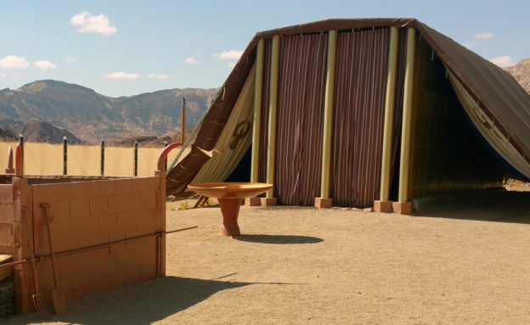
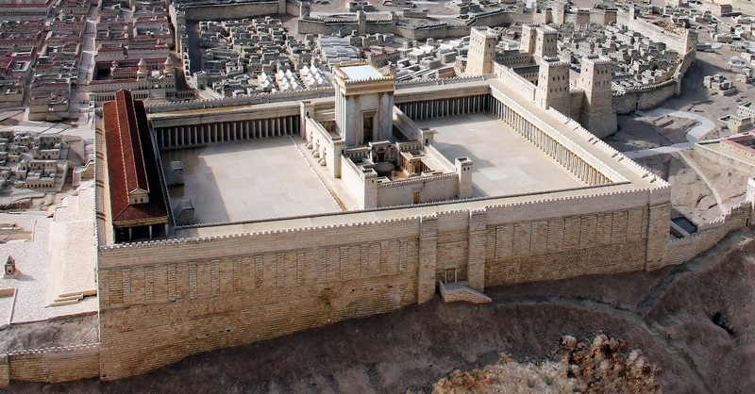
The History of the Tabernacle and the Temple
The Tabernacle (and Temple) was…
Part of the Old Testament or Covenant
You must build a Tabernacle…
Exodus 25:9
Solomon, my son… The Lord has chosen you to build a Temple as his sanctuary.
1 Chronicles 28:9,10

Slide 19
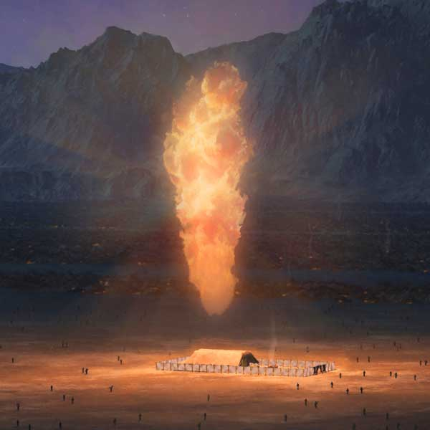
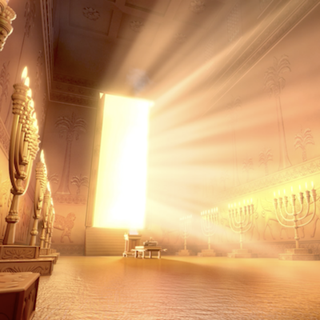
The History of the Tabernacle and the Temple
The Tabernacle (and Temple) was…
Where God Dwelt
And God’s presence was seen as:
Fire and Cloud/Wind
Then the cloud covered the Tabernacle, and the glory of the Lord filled the Tabernacle…
The cloud of the Lord hovered over the Tabernacle during the day, and at night fire glowed inside the cloud…
Exodus 40:34, 38
When the priests came out of the Holy Place, a thick cloud filled the Temple of the Lord.
1 Kings 8:10

Slide 20
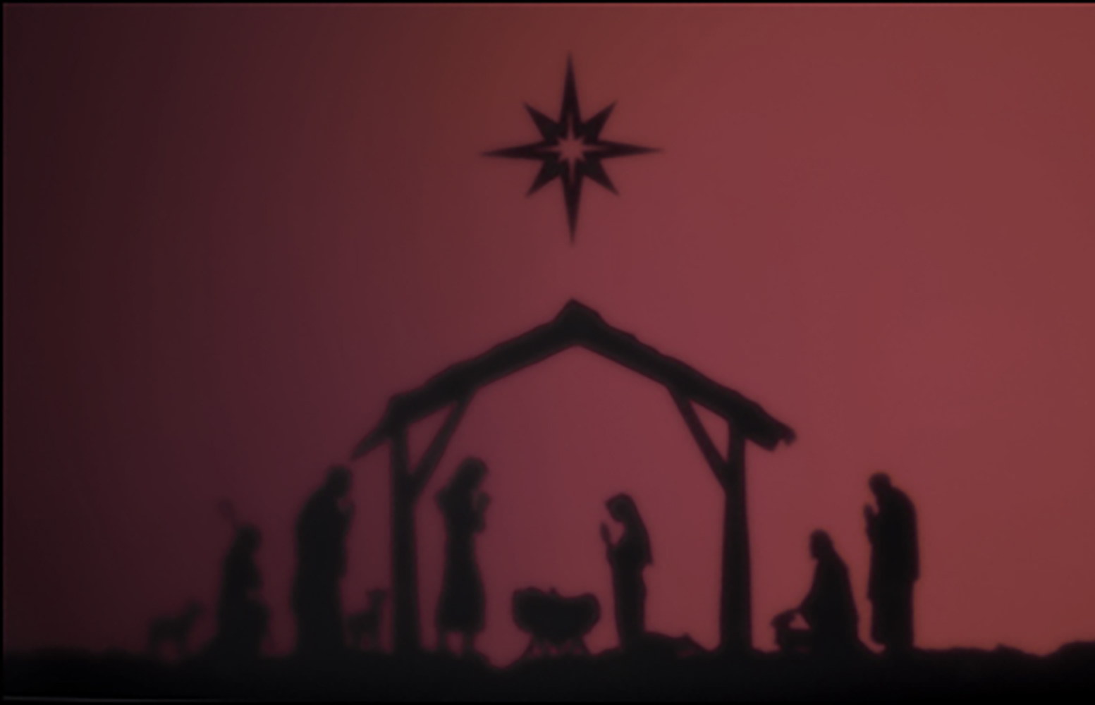
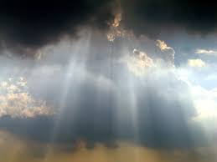
The History of Jesus
She will give birth to a son, and they will call him Immanuel, which means ‘God is with us.’”
Matthew 1:23
In fact, it is best for you that I go away, because if I don’t, the Advocate[a] won’t come. If I do go away, then I will send him to you. And when he comes, he will convict the world of its sin, and of God’s righteousness, and of the coming judgment.
John 16:7-9
You will receive power when the Holy Spirit comes upon you. And you will be my witnesses, telling people about me everywhere—in Jerusalem, throughout Judea, in Samaria, and to the ends of the earth.”
Acts 1:8
Jesus
God present with us
From Conception to Ascension

Slide 21

What does all this mean for understanding Acts 2?
Pentecost in Acts 2 shows us:
The start of the
New Covenant
Where God’s Spirit
sustains us
And this spiritual
life is for
foreigners too
And we no longer need a Temple for God to be with us
Because the Holy Spirit lives in us
But everyone who calls on the name of the Lord will be saved.’
Acts 2:21
Pentecost – it was…
Part of the Old Testament or Covenant
‘I will pour out my Spirit upon all people.
Acts 1:17
Pentecost – it shows that…
God gives what is needed to sustain life
“We all hear these people speaking in our own languages about the wonderful things God has done
Acts 1:17
Pentecost – it shows that…
God wishes to sustain the foreigner too
The Tabernacle (and Temple) was…
Part of the Old Testament or Covenant
.. Roaring of a mighty windstorm, flames of fire on each of them
Acts 1:2,3
The Tabernacle (and Temple) was…
Where God Dwelt (think Fire and Cloud/Wind)
I will give you a new heart, and I will put my Spirit in you. – Ezekiel 36:26

Slide 22
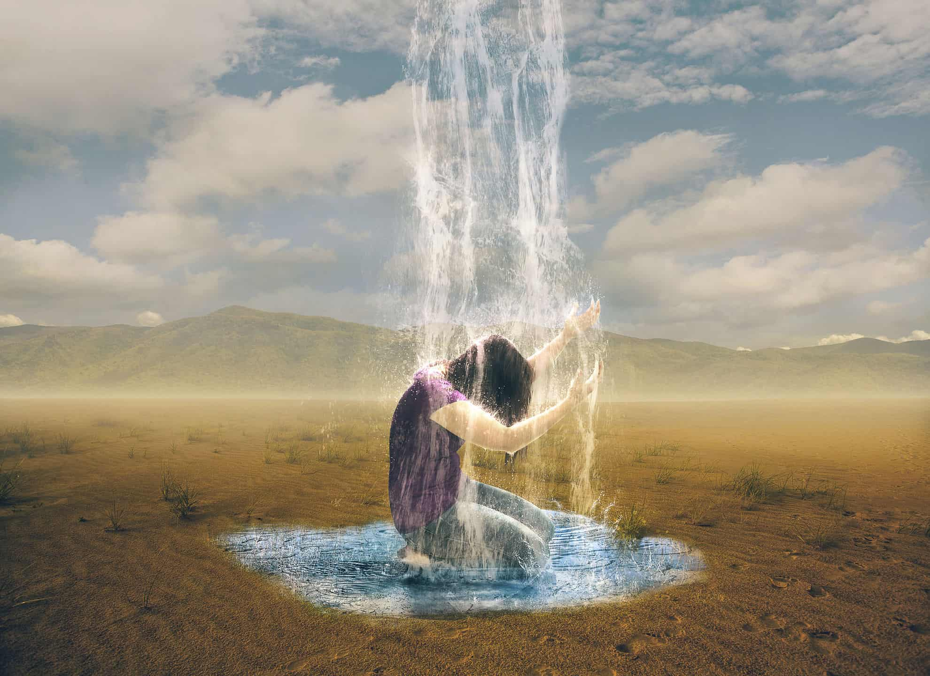
What does all this mean for understanding Acts 2?
Pentecost in Acts 2 shows us:
The start of the
New Covenant
Where God’s Spirit
sustains us
And this spiritual
life is for
foreigners too
And we no longer need a Temple for God to be with us
Because the Holy Spirit lives in us
But everyone who calls on the name of the Lord will be saved.’
Acts 2:21
Pentecost – it was…
Part of the Old Testament or Covenant
‘I will pour out my Spirit upon all people.
Acts 1:17
Pentecost – it shows that…
God gives what is needed to sustain life
“We all hear these people speaking in our own languages about the wonderful things God has done
Acts 1:17
Pentecost – it shows that…
God wishes to sustain the foreigner too
The Tabernacle (and Temple) was…
Part of the Old Testament or Covenant
.. Roaring of a mighty windstorm, flames of fire on each of them
Acts 1:2,3
The Tabernacle (and Temple) was…
Where God Dwelt (think Fire and Cloud/Wind)
I will give you a new heart, and I will put my Spirit in you. – Ezekiel 36:26

Slide 23
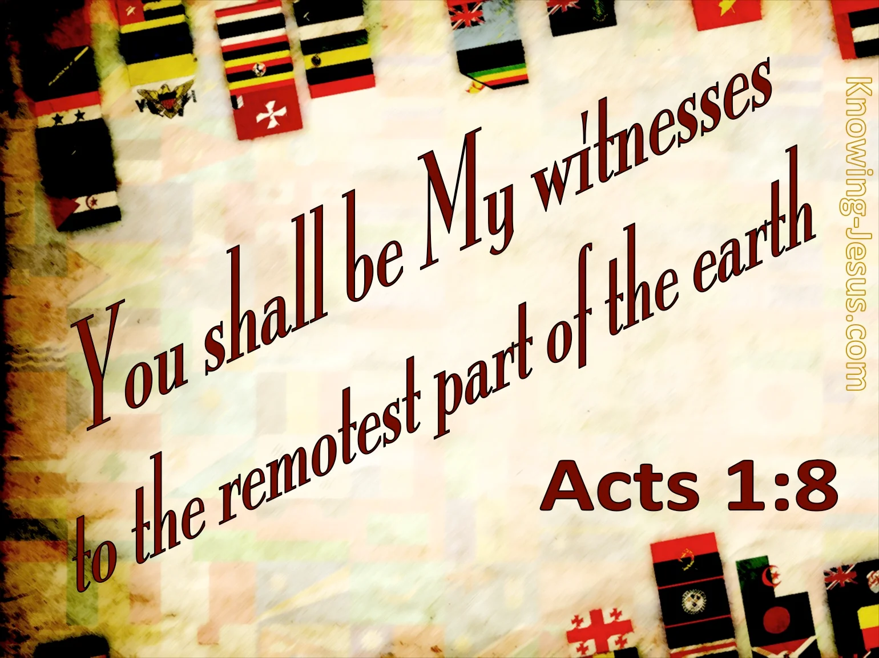
What does all this mean for understanding Acts 2?
Pentecost in Acts 2 shows us:
The start of the
New Covenant
Where God’s Spirit
sustains us
And this spiritual
life is for
foreigners too
And we no longer need a Temple for God to be with us
Because the Holy Spirit lives in us
But everyone who calls on the name of the Lord will be saved.’
Acts 2:21
Pentecost – it was…
Part of the Old Testament or Covenant
‘I will pour out my Spirit upon all people.
Acts 1:17
Pentecost – it shows that…
God gives what is needed to sustain life
“We all hear these people speaking in our own languages about the wonderful things God has done
Acts 1:17
Pentecost – it shows that…
God wishes to sustain the foreigner too
The Tabernacle (and Temple) was…
Part of the Old Testament or Covenant
.. Roaring of a mighty windstorm, flames of fire on each of them
Acts 1:2,3
The Tabernacle (and Temple) was…
Where God Dwelt (think Fire and Cloud/Wind)
I will give you a new heart, and I will put my Spirit in you. – Ezekiel 36:26

Slide 24
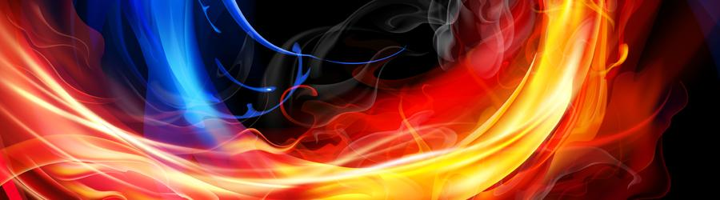

What does all this mean for understanding Acts 2?
Pentecost in Acts 2 shows us:
The start of the
New Covenant
Where God’s Spirit
sustains us
And this spiritual
life is for
foreigners too
And we no longer need a Temple for God to be with us
Because the Holy Spirit lives in us
But everyone who calls on the name of the Lord will be saved.’
Acts 2:21
Pentecost – it was…
Part of the Old Testament or Covenant
‘I will pour out my Spirit upon all people.
Acts 1:17
Pentecost – it shows that…
God gives what is needed to sustain life
“We all hear these people speaking in our own languages about the wonderful things God has done
Acts 1:17
Pentecost – it shows that…
God wishes to sustain the foreigner too
The Tabernacle (and Temple) was…
Part of the Old Testament or Covenant
.. Roaring of a mighty windstorm, flames of fire on each of them
Acts 1:2,3
The Tabernacle (and Temple) was…
Where God Dwelt (think Fire and Cloud/Wind)
I will give you a new heart, and I will put my Spirit in you. – Ezekiel 36:26

Slide 25
What does all this mean for understanding Acts 2?
Pentecost in Acts 2 shows us:
The start of the
New Covenant
Where God’s Spirit
sustains us
And this spiritual
life is for
foreigners too
And we no longer need a Temple for God to be with us
Because the Holy Spirit lives in us
But everyone who calls on the name of the Lord will be saved.’
Acts 2:21
Pentecost – it was…
Part of the Old Testament or Covenant
‘I will pour out my Spirit upon all people.
Acts 1:17
Pentecost – it shows that…
God gives what is needed to sustain life
“We all hear these people speaking in our own languages about the wonderful things God has done
Acts 1:17
Pentecost – it shows that…
God wishes to sustain the foreigner too
The Tabernacle (and Temple) was…
Part of the Old Testament or Covenant
.. Roaring of a mighty windstorm, flames of fire on each of them
Acts 1:2,3
The Tabernacle (and Temple) was…
Where God Dwelt (think Fire and Cloud/Wind)
I will give you a new heart, and I will put my Spirit in you. – Ezekiel 36:26

Slide 26
What does all this mean for understanding Acts 2?
Pentecost in Acts 2 shows us:
The start of the
New Covenant
Where God’s Spirit
sustains us
And this spiritual
life is for
foreigners too
And we no longer need a Temple for God to be with us
Because the Holy Spirit lives in us
But everyone who calls on the name of the Lord will be saved.’
Acts 2:21
Pentecost – it was…
Part of the Old Testament or Covenant
‘I will pour out my Spirit upon all people.
Acts 1:17
Pentecost – it shows that…
God gives what is needed to sustain life
“We all hear these people speaking in our own languages about the wonderful things God has done
Acts 1:17
Pentecost – it shows that…
God wishes to sustain the foreigner too
The Tabernacle (and Temple) was…
Part of the Old Testament or Covenant
.. Roaring of a mighty windstorm, flames of fire on each of them
Acts 1:2,3
The Tabernacle (and Temple) was…
Where God Dwelt (think Fire and Cloud/Wind)
I will give you a new heart, and I will put my Spirit in you. – Ezekiel 36:26

Slide 27
So what does this mean for us?

Slide 28
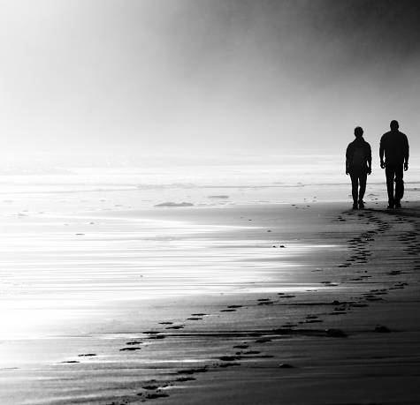
So what does this mean for us?
God is with you

Slide 29
So what does this mean for us?
God is with you
You have been changed

Slide 30
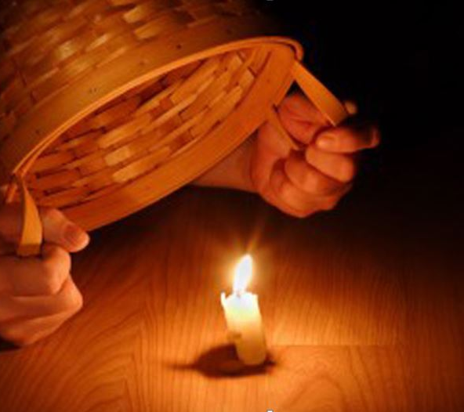
So what does this mean for us?
God is with you
You have been changed
And changed for a reason

